Slide 1
Colombia - a ‘rejected’ peace

Slide 2
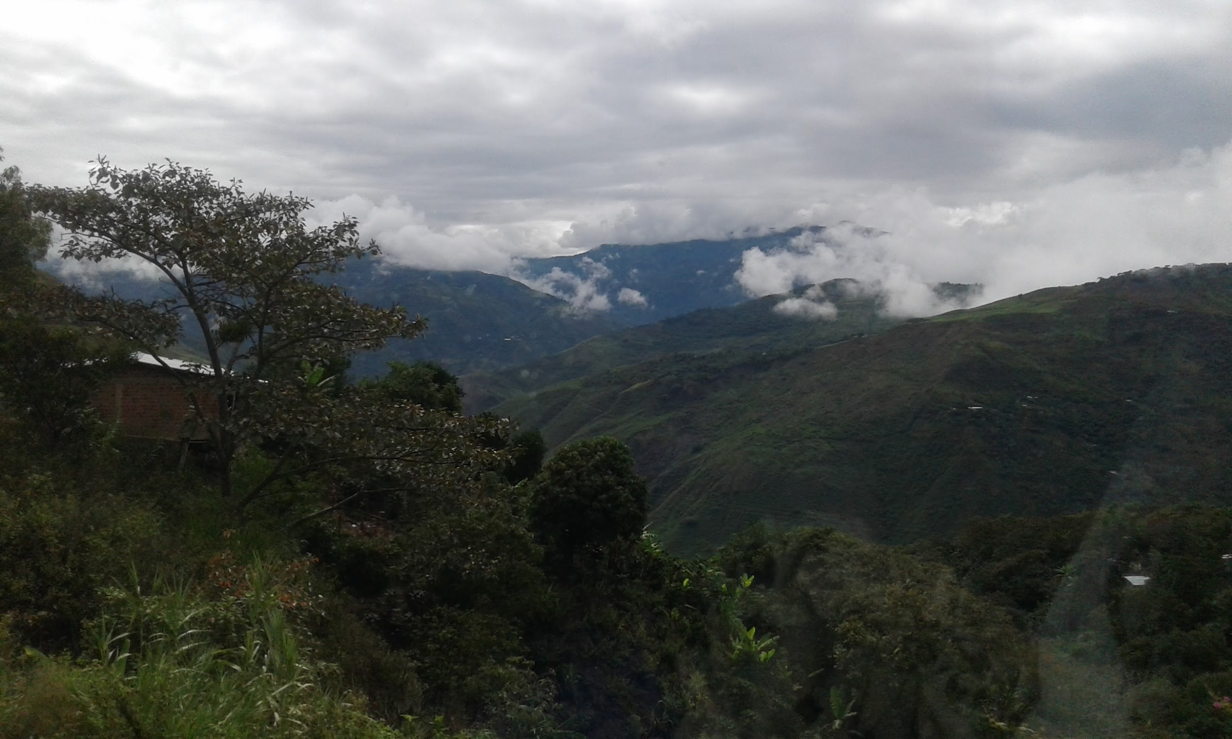
Background - as a political movement
Land held in the hands of 20 richest families - FARC was born out of a political movement to institute land reform in the 1950s.
Colombia never had the same Chavismo or Correaismo as its neighbors (US influence) - so the movement was quashed in the cities and moved to the rural areas and forest
Paramilitary groups and bacrimes
Falsos positivos
Nariño department, Colombia

Slide 3
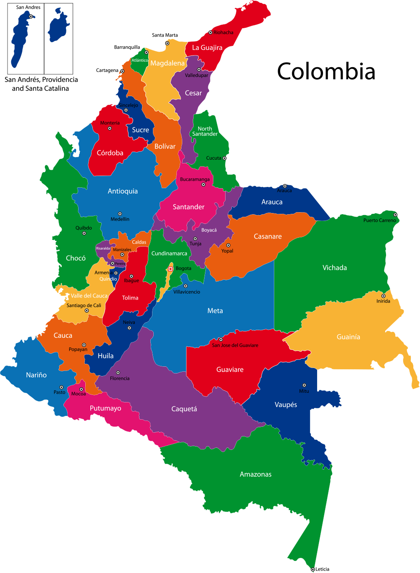
FARC territories
Primarily in the Pacific - Nariño, Cauca, Valle de Cauca, Putumayo, Caquetá, Chocó. Areas that have a lot of coca production.
ELN exists in areas closer to Venezuela - Arauca, Norte Santander - and in the Caribbean, Antioquia, Cordoba - smuggling economies.
Only 7,000 soldiers in all of Colombia - and only 300 in Nariño- but their network is wide-reaching.

Slide 4
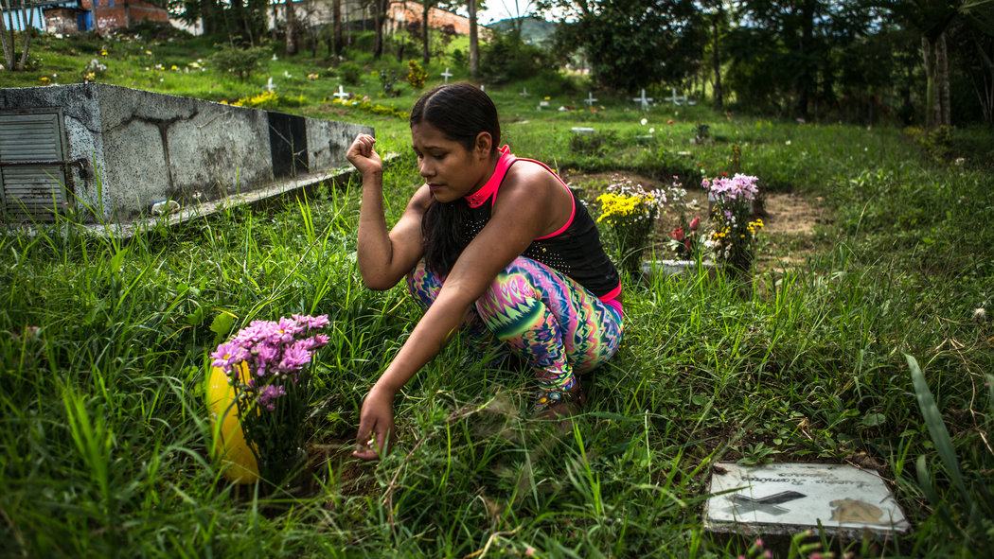
Who are they?
Often hail from rural areas - indigenous populations particularly. Many were kidnapped as children, or had few economic opportunities where they were living.
http://www.nytimes.com/2016/04/28/world/americas/colombia-farc-child-soldiers.html
http://www.nytimes.com/2016/03/19/world/americas/colombia-farc-rebels.html?_r=0
http://www.nytimes.com/2016/08/26/world/americas/colombia-farc-peace-deal.html

Slide 5
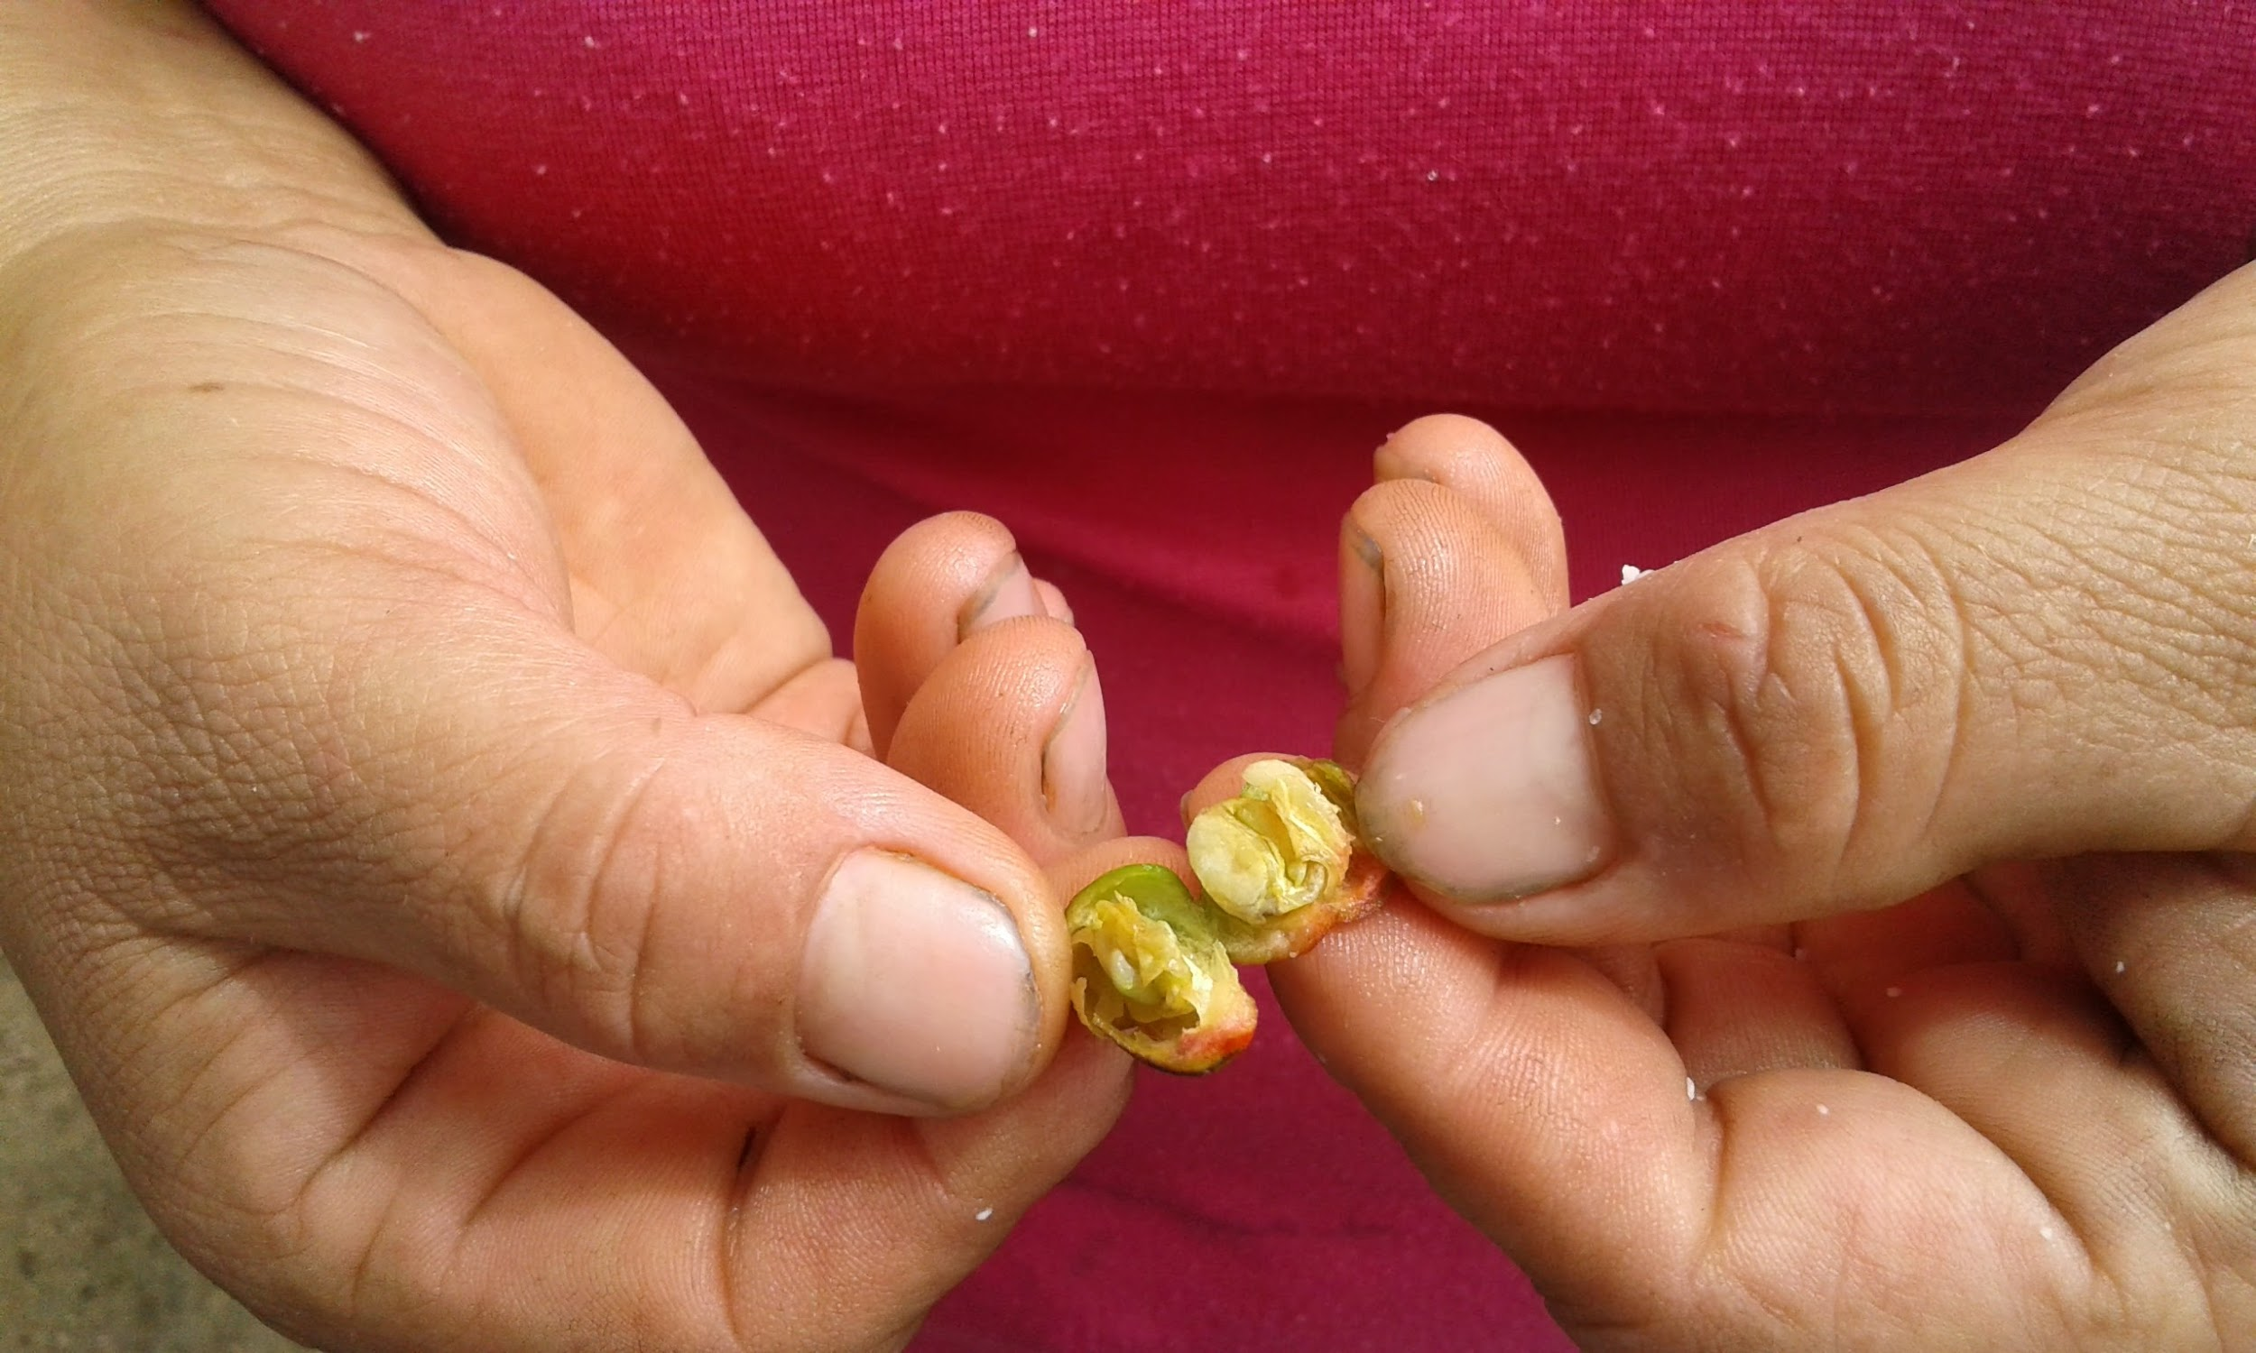
Linkages to drug trafficking
Official position - taxes on the drug trade in their territories
Why would smallholder farmers in Colombia grow coca if it’s so dangerous?
Dangers - aerial spraying of coca fields, health impacts + production impacts

Slide 6

Culture of peace
After 52 years of war, 6 million displacements and over 200,000 deaths, GoC entered into its fourth round of peace talks in 2012
GoC is highly invested in peace and did an economic analysis of how much war costs v. peace per year in terms of environmental damage
Created a new Post-Conflict Ministry in the build-up to October 2nd
Reparations Victims Unit - Government Agency to reintegrate former FARC fighters and give reparations to victims

Slide 7
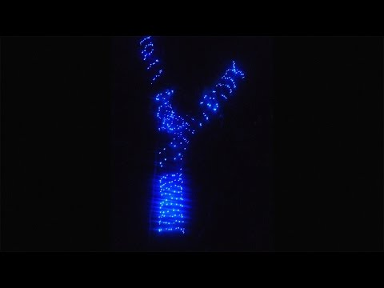
Government attempts to de-arm the FARC

Slide 8
What the peace accords would have been
Political participation of the FARC in the House and the Senate - 5 guaranteed seats in each over the next two election cycles
Rural development and land reform
Drug trade
Justice - no war crimes, no jail time as long as they participate in in a truth tribunal and reintegration programs that help victims; war crimes, no jail time, 8 years of restricted movement; convicted war criminals up to 20 years in prison - applies for both FARC and Colombian military

Slide 9
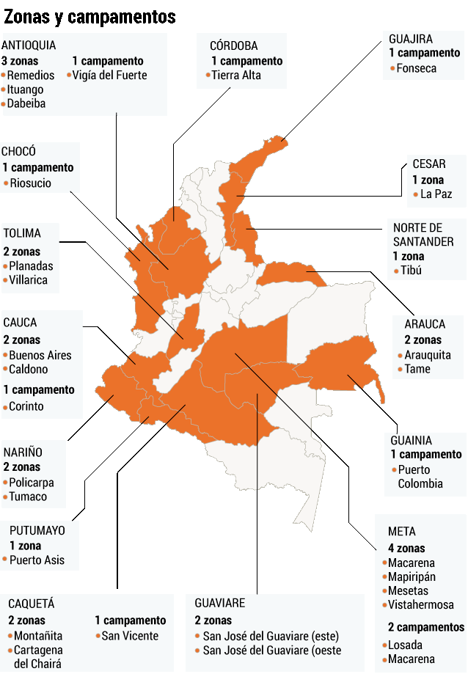
Transitory rural settlement normalization zones
23 camps manned by the UN, the police and the military, where FARC combatants can de-arm and engage in productive activities with local communities and receive trainings on how to adjust to civilian life
Rebels can stay there for up to six months, then will be reunited with their families

Slide 10
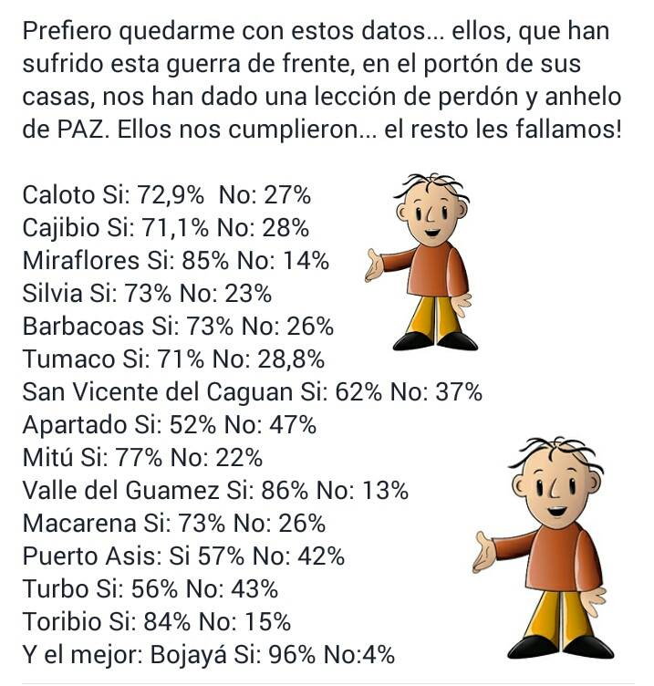
What happened?
JMS wanted to legitimize the historic peace agreements - negotiated by the government of Cuba in Havana - by having the nation approve them
50.21 percent of the population voted no
But many of the places where conflict was most hit - voted SI - including BOJAYÁ

Slide 11
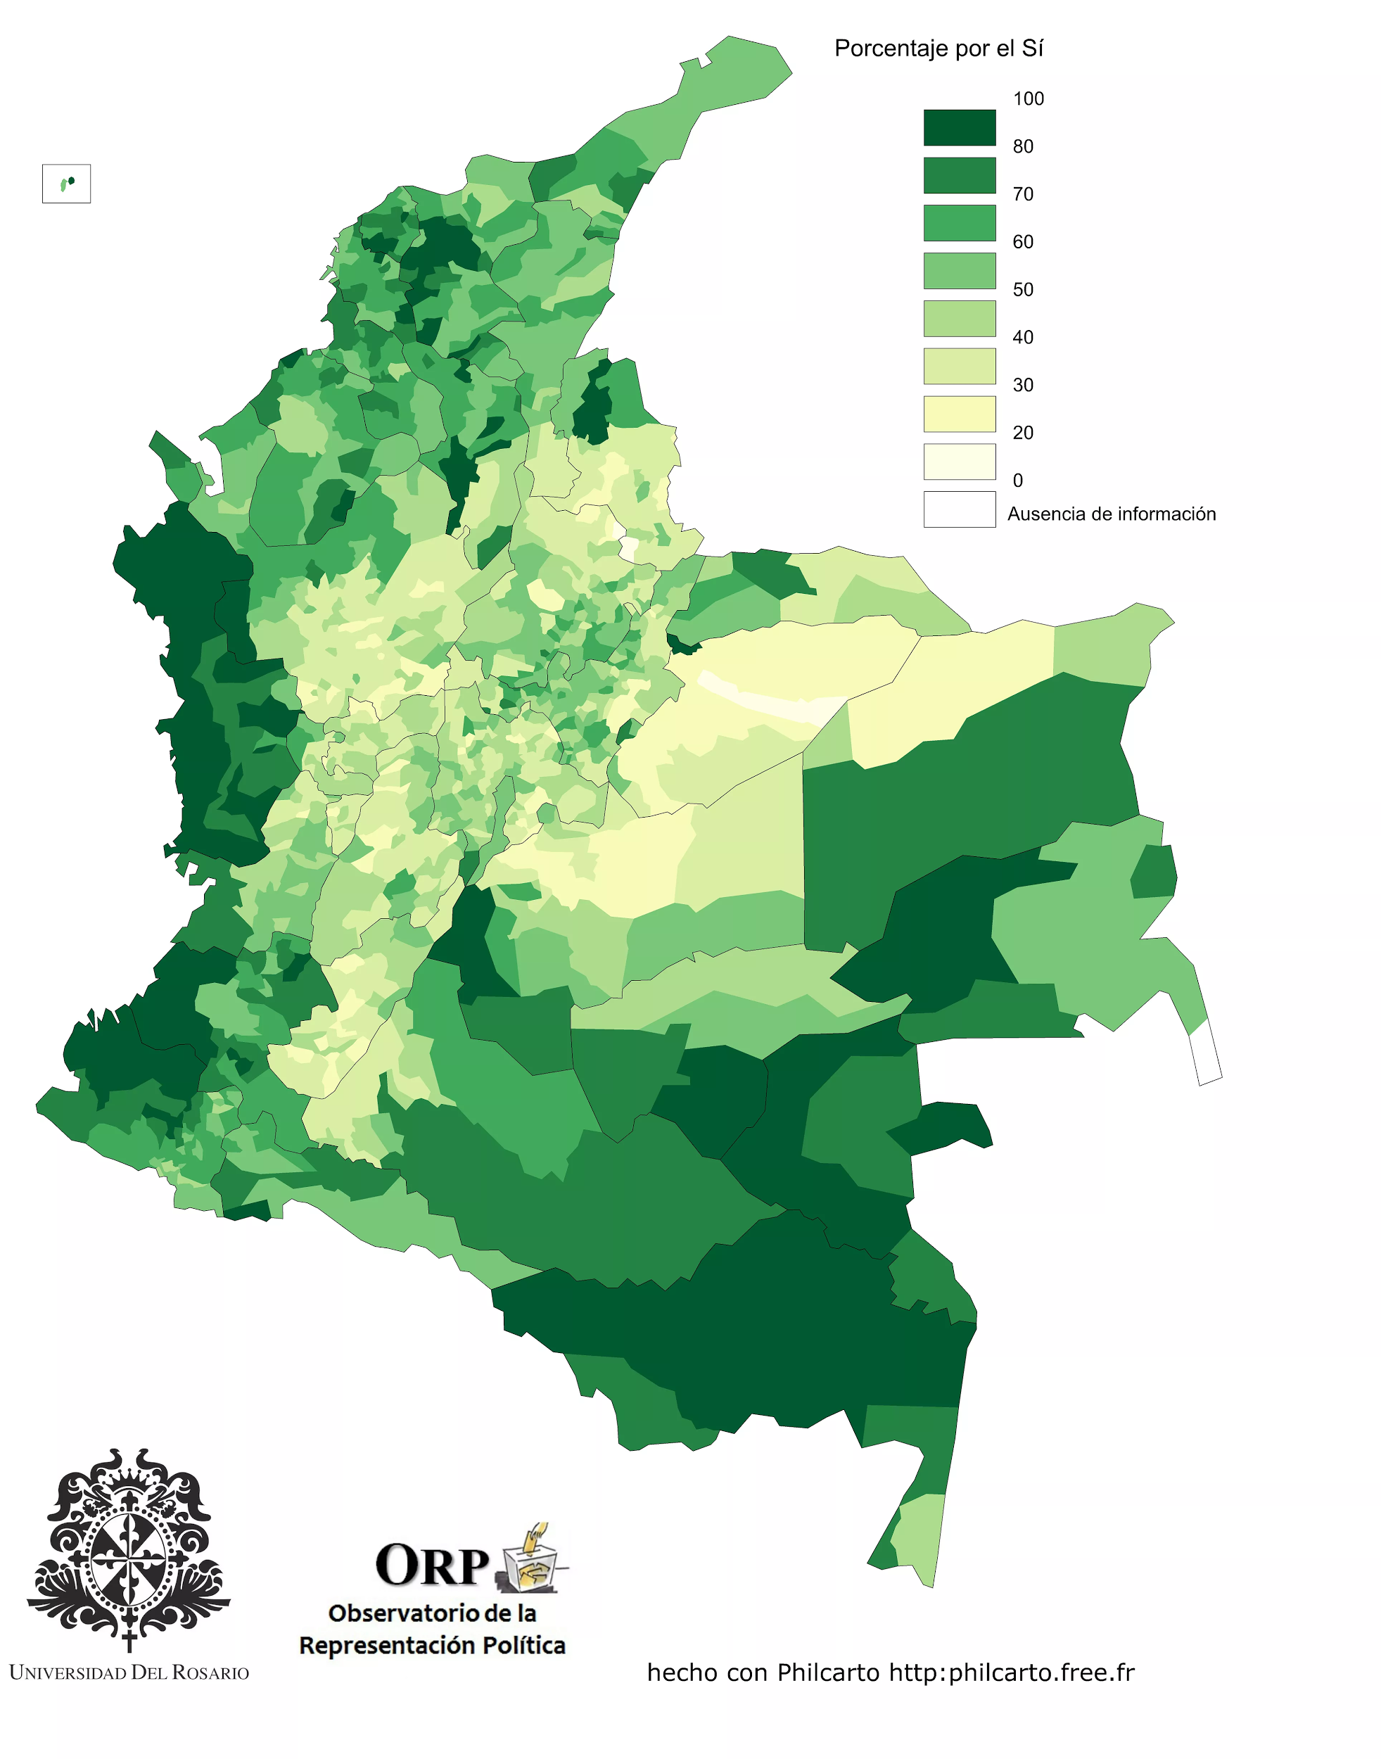
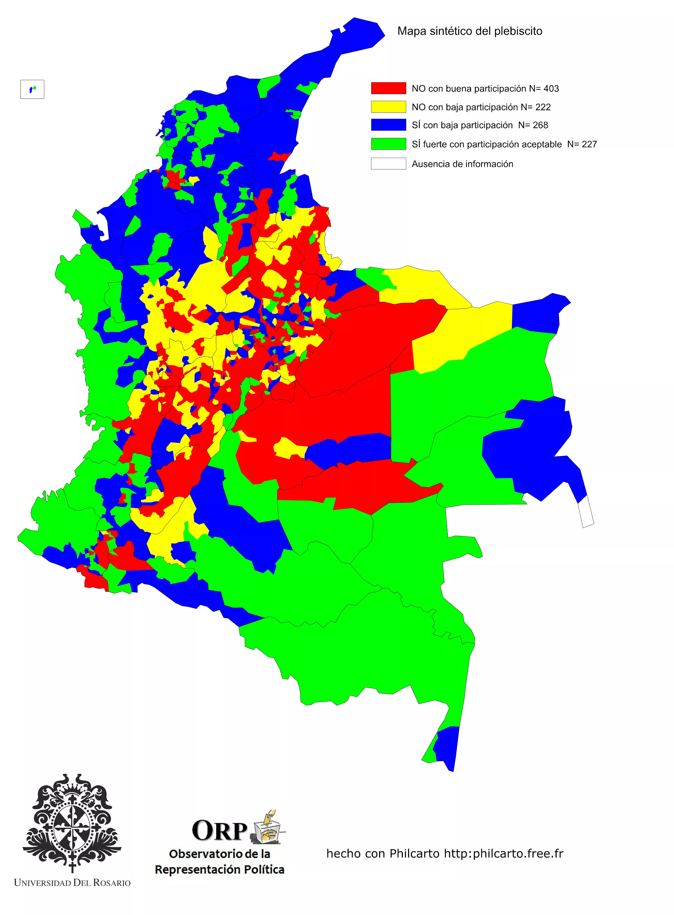

Slide 12
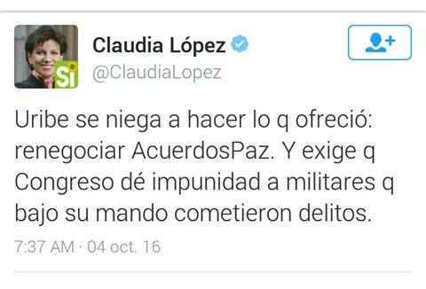
Opposition to the peace agreements
Amnesty for drug trafficking and no jail time for FARC members who confessed in a truth tribunal
Political participation of the FARC - fear of becoming like Venezuela
Vested interests in keeping war going

Slide 13
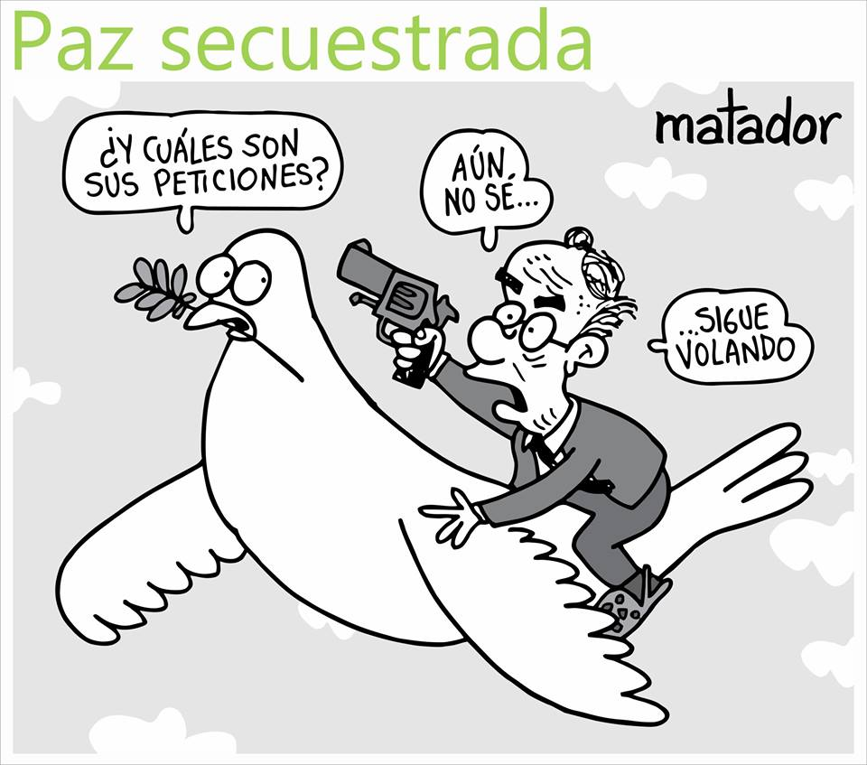
Aftermath
FARC and GoC agreed to keep the bilateral cease-fire effective until 31 October
Juan Manuel Santos is trying to peace together a coalition to re-negotiate the peace accords; No team wants to be at the negotiating table
Some believe that this gives the government more leverage in making the FARC concede to jail time
Peace marches throughout the country yesterday

Slide 14
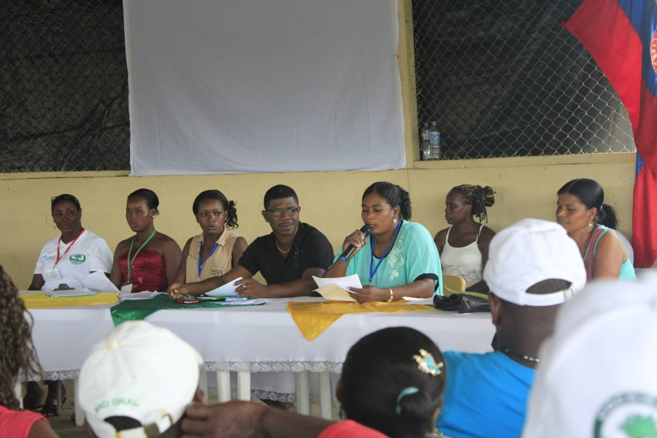
Bojayá letter
Urges the country to accept the peace agreement
Invitamos al Ex Presidente Álvaro Uribe y al ex Procurador General de la Nación a vivir en nuestro territorio por una temporada -sin escoltas que los protejan- para que comprendan como es estar en medio del conflicto que nos afecta y de la pobreza, y por qué los acuerdos deben ser respetados por ellos también -
http://www.memoriasdelatrato.org/index.php/component/k2/item/220-bojaya-y-atrato-medio-urge-respetar-el-si-de-las-victimas-frente-al-acuerdo-de-paz

